Slide 1
4th CAREC Think Tanks Development Forum
Trading for Shared Prosperity
Xi’an, Shaanxi, People’s Republic of China
27-28 August 2019
Development of Cross-border economic corridors in central asia
Bahodir Ganiev
Senior Advisor
Center for Economic Development
Tashkent, Uzbekistan

Slide 2
Outline
Definition of a cross-border economic corridor (CBEC)
Links between CAREC 2030, CITA 2030 and development of CBECs in Central Asia
Rationale for development of CBECs in Central Asia
Challenges and favorable factors
Almaty-Bishkek economic corridor (ABEC)
Shymkent-Tashkent-Khujand economic corridor (STKEC)

Slide 3
What is a CBEC?
A CBEC is an integrated economic region that spans two or more countries
Typically, it includes several big cities and the areas around and between these cities
It is characterized by superior connectivity (including transport and digital connectivity), seamless movement of goods and people across borders, and extensive cross-border trade and investment flows
It involves cross-border value-chains and clusters of economic activity

Slide 4
CAREC 2030, CITA 2030 and
Development of CBECs in Central Asia
CAREC 2030
Operational Priorities
1. Economic
and financial
stability
2. Trade, tourism,
and economic
corridors
3. Infrastructure
and economic
connectivity
4. Agriculture
and water
5. Human development
Contribution to implementation
CITA 2030
Pillars
1. Trade expansion from increased market access
2. Greater diversification
3. Stronger institutions for trade
Development
of CBECs in
Central Asia

Slide 5
Why are CBECs Needed in Central Asia?
Their economies are small and not well integrated into the global economy
Bilateral trade flows between some CACs are small
The stock of inward FDI is small in most CACs
The level of urbanization is low in the CACs
Manufacturing and services sectors are underdeveloped in the CACs
Primary commodities dominate their exports

Slide 6
Population and GDP of CACs, 2018
 | Population | GDP at Current Prices | GDP at PPP | Share of World GDP at PPP
 | (Million persons) | (Million US dollars) |  | (%)
Kazakhstan | 18.5 | 170.5 | 508.6 | 0.38
Kyrgyz Republic | 6.4 | 8.1 | 24.5 | 0.02
Tajikistan | 9.1 | 7.5 | 31.1 | 0.02
Turkmenistan | 5.8 | 44.1 | 112.7 | 0.08
Uzbekistan | 32.7 | 41.2 | 250.3 | 0.19
All CACs | 72.4 | 271.5 | 927.3 | 0.69
Memorandum item:
Japan | 126.5 | 4971.9 | 5594.5 | 4.14
Source: International Monetary Fund.

Slide 7
Ratio of Total Merchandise Trade to GDP in
Selected Countries, 2018 (%)
Source: World Bank.

Slide 8
Share of Bilateral Trade in Merchandise
Trade of CACs, 2018 (%)
 | Trading Partners
 | Kazakhstan | Kyrgyz Republic | Tajikistan | Turkmenistan | Uzbekistan
Kazakhstan |  | 0.8 | 0.9 | 0.1 | 2.7
Kyrgyz Republic | 10.6 |  | 0.9 | 0.1 | 5.2
Tajikistan | 4.7 | 1.2 |  | n.a. | 31.1
Turkmenistan | 0.9 | 0.0 | n.a. |  | 0.6
Uzbekistan | 10.7 | 1.4 | 0.9 | 0.3
Source: International Monetary Fund and the authors’ computations.

Slide 9
Ratio of Stock of Inward FDI to GDP in
Selected Countries, 2018 (%)
Source: United Nations Conference for Trade and Development.

Slide 10
Commodity Composition of Kazakhstan’s
Merchandise Exports, 2018
Source: UN Comtrade.

Slide 11
Commodity Composition of Kyrgyz Republic’s
Merchandise Exports, 2018
Source: UN Comtrade.

Slide 12
Commodity Composition of Tajikistan’s
Merchandise Exports, 2018
Source: Customs Service under the Government of the Republic of Tajikistan.

Slide 13
Commodity Composition of Uzbekistan’s
Merchandise Exports, 2018
Source: Central Bank of the Republic of Uzbekistan.

Slide 14
Number of International Visitors to
Selected Countries, 2017 (millions)
Source: World Bank.

Slide 15
Share of Urban Agglomerations of More Than 1 Million
in Total Population in Selected Countries, 2017 (%)
Source: World Bank.

Slide 16
Share of ICT Services in Total Trade in Services
in Selected Countries, 2018 (%)
Source: United Nations Conference for Trade and Development.

Slide 17
Benefits of CBECs for CACs
Development of CBECs can help the CACs
deeper integrate their economies with each other and with the global economy
attract more FDI and international tourists
develop urban agglomerations, manufacturing and the services sector
diversify the composition of exports away from primary commodities and towards manufactures and services
make a greater variety of higher quality goods and services available to consumers at lower prices

Slide 18
Major Challenges in Developing
CBECs in Central Asia
Overcoming misperceptions of the general public about foreign trade and resistance of vested interests to reforms
Securing and sustaining the commitment of numerous stakeholders
Enhancing trade facilitation and improving the overall business environment
Effectively managing the risks associated with regional and global economic integration and rapid urbanization

Slide 19
Selected International Rankings Related to
Trade Facilitation and Business Environment
 | KAZ | KYR | TAJ | TUR | UZB
Logistics Performance Index 2018 (160 countries)
Overall logistics performance | 71 | 108 | 134 | 126 | 99
Quality of trade and transport-related infrastructure | 81 | 103 | 127 | 117 | 77
Efficiency of customs clearance process | 65 | 55 | 150 | 111 | 140
Ease of arranging competitively priced international shipments | 84 | 138 | 133 | 136 | 120
Competence and quality of logistics services | 90 | 114 | 116 | 120 | 88
Doing Business 2019 (190 countries)
Overall ease of doing business | 28 | 70 | 126 | n.a. | 76
Ease of trading across borders | 102 | 70 | 148 | n.a. | 165
Source: World Bank.

Slide 20
Favorable Factors
Strong historical, cultural and ethnic ties among the CACs
Improvement in the bilateral relations between many CACs in recent years
High priority attached by the governments of most CACs to deepening regional and global economic integration
Membership of Kazakhstan and Kyrgyz Republic in the EAEU
Membership of Kazakhstan, Kyrgyz Republic, Tajikistan and Uzbekistan in the CIS free trade agreement and the SCO
Membership of Kazakhstan, Kyrgyz Republic and Tajikistan in the WTO and Uzbekistan’s renewed efforts to join the WTO
China’s Belt and Road Initiative

Slide 21
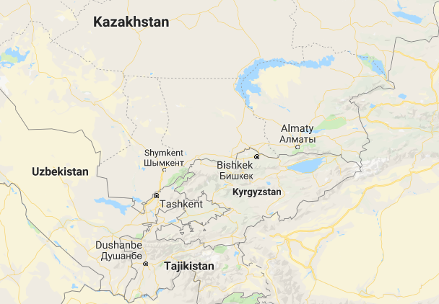
Geographic Coverage of ABEC
Kazakhstan:
Almaty city and the surrounding areas
Kyrgyz Republic:
Bishkek city and the surrounding areas, including Issyk-Kul lake
Issyk-Kul lake
Source: Google Maps

Slide 22
Major Events in ABEC Development
2014
Signing of MoU between Mayors of Almaty and Bishkek
2017
Creation of ABEC Subcommittee of Kazakhstan-Kyrgyz Republic Intergovernmental Council
2018-2019
Three ABEC Subcommittee Meetings
2015-2016
Four Joint Working Group Meetings

Slide 23
Institutional Setup for ABEC Development
Kazakhstan-Kyrgyz Republic Intergovernmental Council
ABEC Subcommittee
Agriculture SWG
Tourism
SWG
Connectivity SWG
ADB as observer and supporter

Slide 24
Achievements in ABEC Development
Sector analysis and policy dialog to develop an innovative concept
Identification of investment priorities in
agriculture
tourism
transport
social sectors

Slide 25
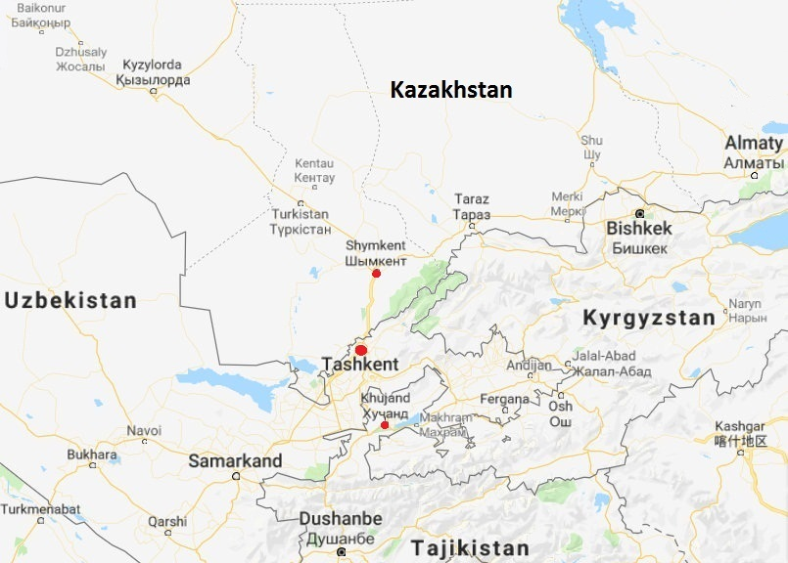
Geographic Coverage of STKEC
Kazakhstan:
Shymkent city
Turkestan province
Uzbekistan:
Tashkent city
Tashkent province
Tajikistan:
Sughd province, including Khujand city
Note: About 15% of the total population of Central Asia live in this region
Source: Google Maps

Slide 26
Focus Areas for STKEC Development (Preliminary)
Improvement of transport connectivity
Modernization of border crossing procedures and infrastructure
Development of cross-border agricultural value chains
Modernization of SPS measures and development of quality infrastructure for exports of agricultural and food products
Development of regional tourism
Development of special economic zones and industrial parks

Slide 27
Priority Actions to Develop STKEC (Preliminary)
Harmonization of transport regulations and abolition of quotas for entry of foreign trucks
Introduction of e-TIR and a multi-country tourist visa
Establishment of green/express lanes at border crossing points
Development of a network of modern agri-logistics centers
Transition to risk-based SPS control over imports
Upgrading of SPS laboratories

Slide 28
Thank You
Email address for inquiries:
bganiev2014@gmail.com

